Slide 1
Econ 200 Module 5 Lecture 12

Slide 2
Outline
Perfectly Competitive Markets
Revenue in PC Markets
Profit Maximization for PC Firms
Showing Profit Graphically
Reading: Ch 13

Slide 3
Market Structures
Market Structures: models of how the firms in a market interact with buyers to sell their output.
In decreasing order of competitiveness:
Perfectly competitive markets
Monopolistically competitive markets
Oligopolies, and
Monopolies.
Each market structure will be applicable to different real-world markets and will give us insight into how firms in certain types of markets behave.

Slide 4
Introduction to Perfectly Competitive Markets
The first market structure we will examine is the perfectly competitive market: one in which
There are many buyers and sellers;
All firms sell identical products; and
There are no barriers to new firms entering the market
The first and second conditions imply that perfectly competitive firms are price-takers: they are unable to affect the market price.

Slide 5
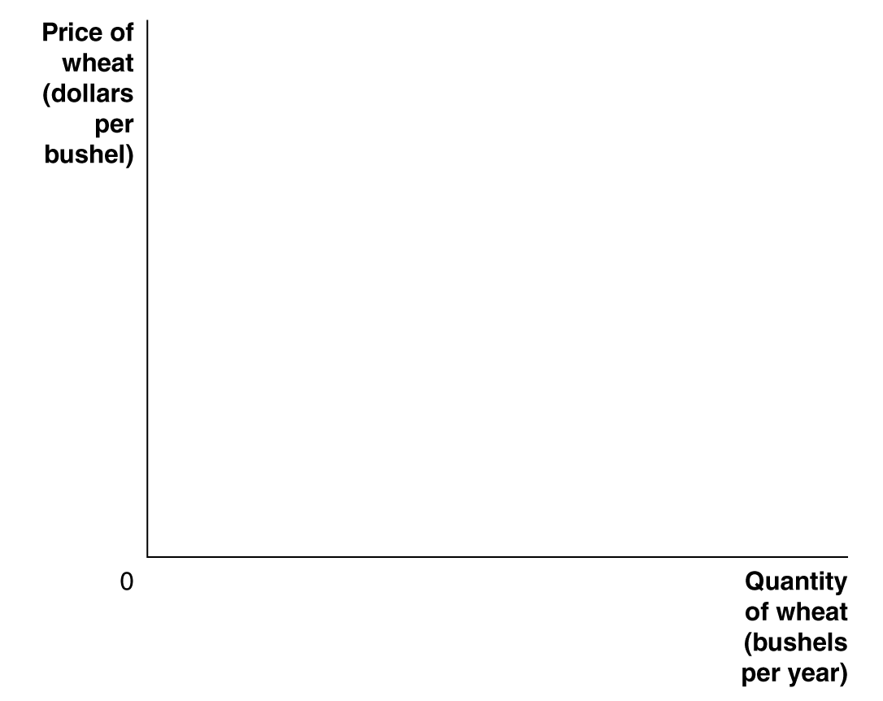
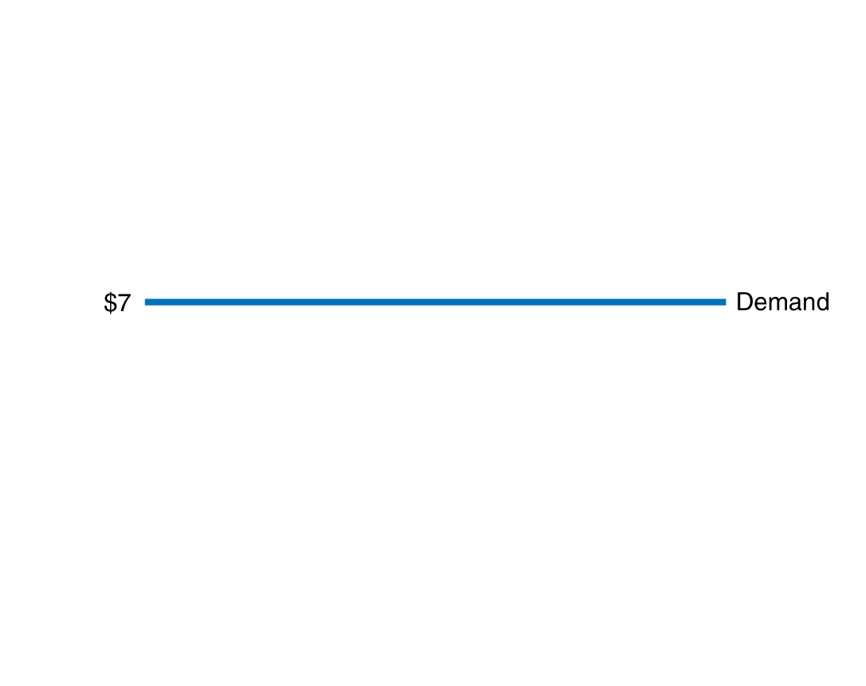
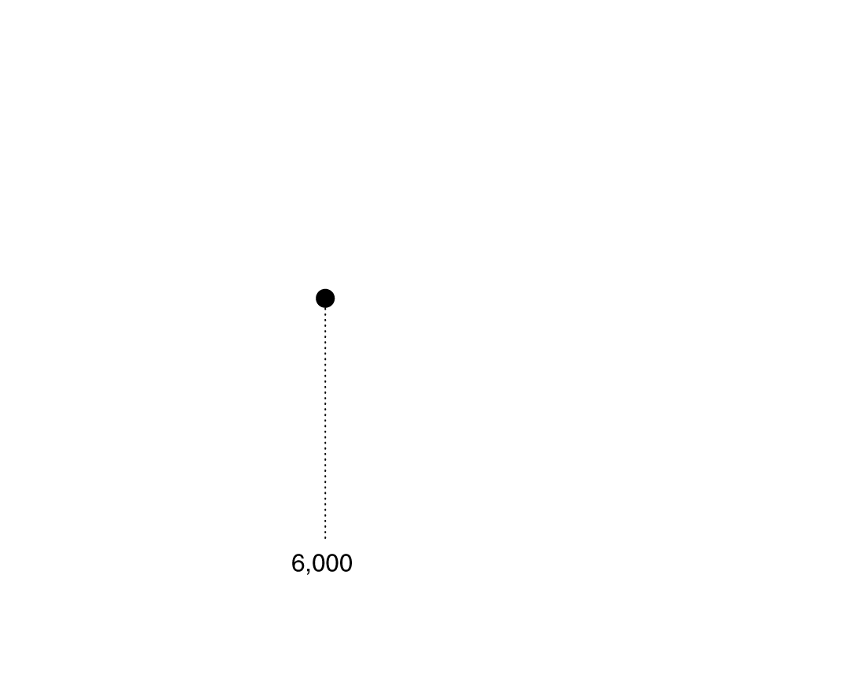
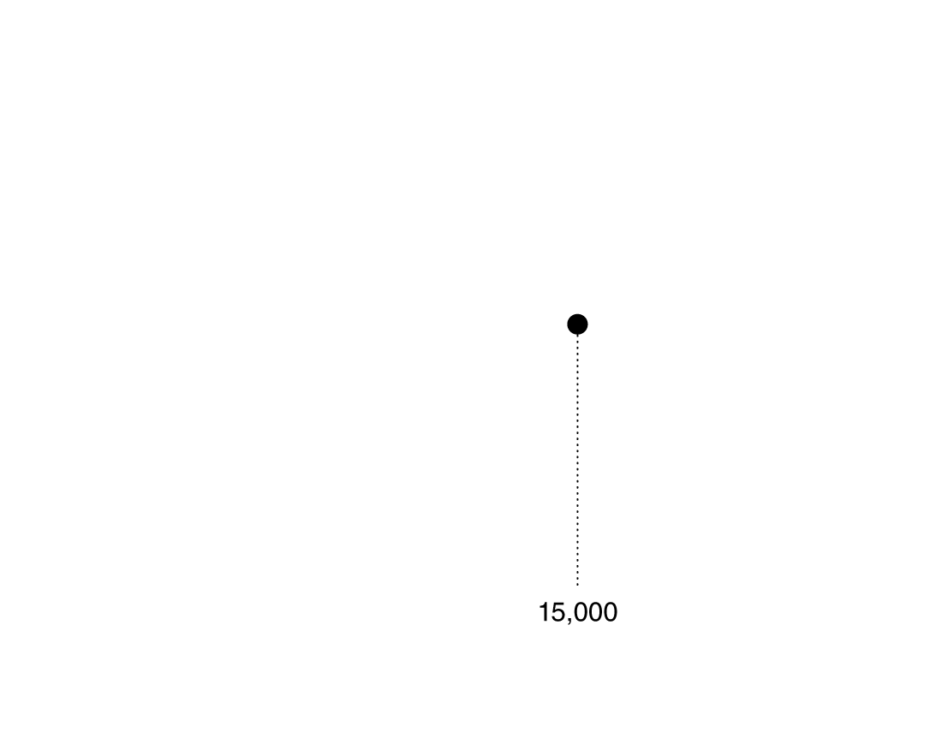
The Demand Curve for a Perfectly Competitive Firm
By definition, a perfectly competitive firm is too small to affect the market price no matter what quantity is sold.
Notes:
A firm in a perfectly competitive market is
selling exactly the same product as many
other firms. Therefore, it can sell as much
as it wants at the current market price, but
it cannot sell anything at all if it raises the
price by even 1 cent. As a result, the demand
curve for a perfectly competitive firm’s
output is a horizontal line. In the figure,
whether the wheat farmer sells 6,000 bushels
per year or 15,000 bushels has no effect
on the market price of $7.

Slide 6
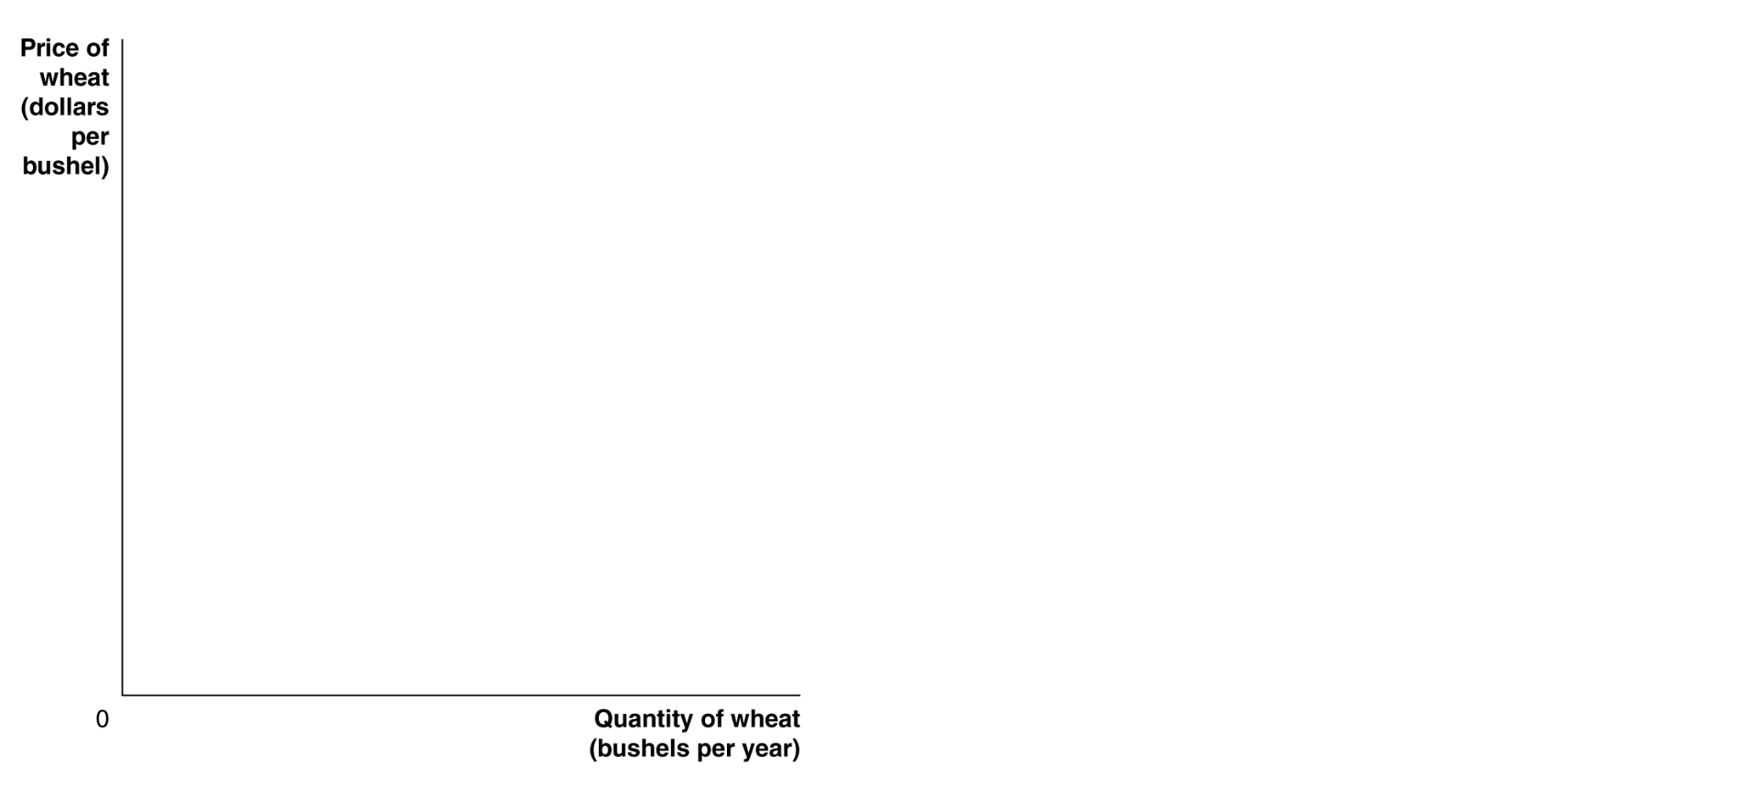
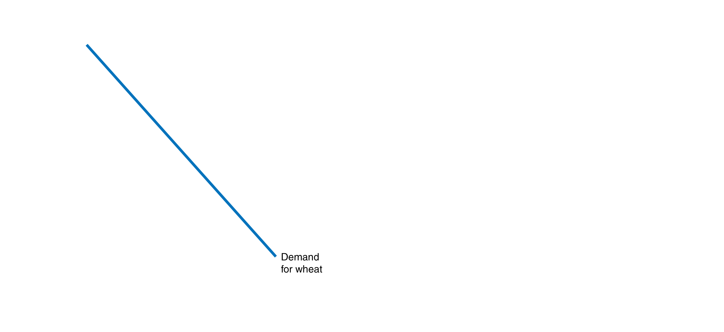
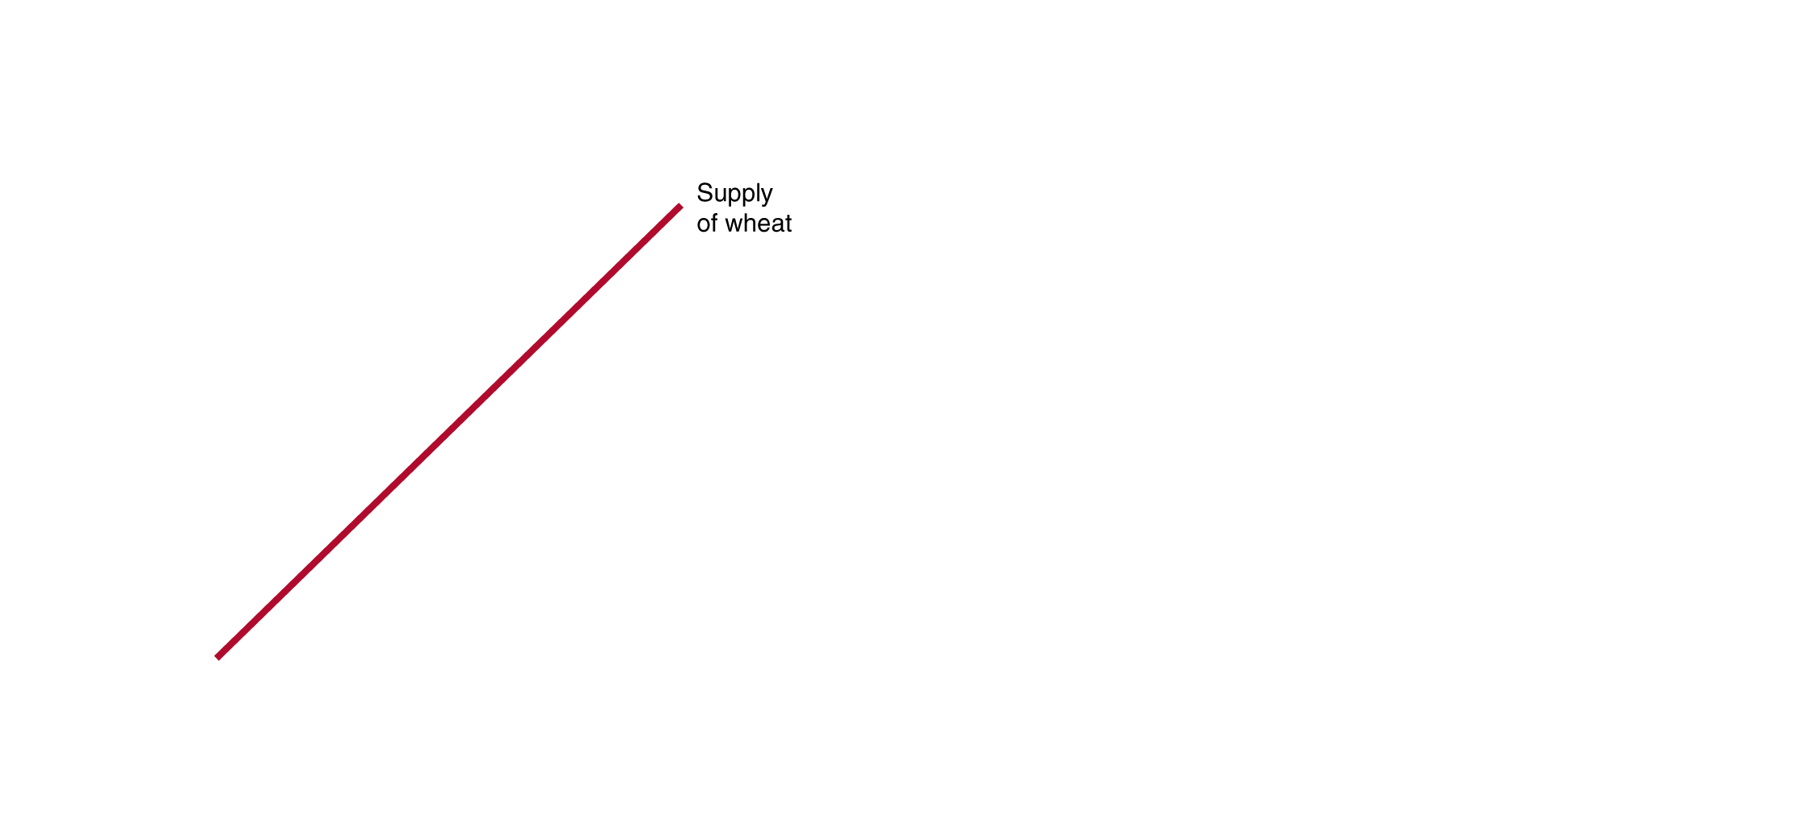
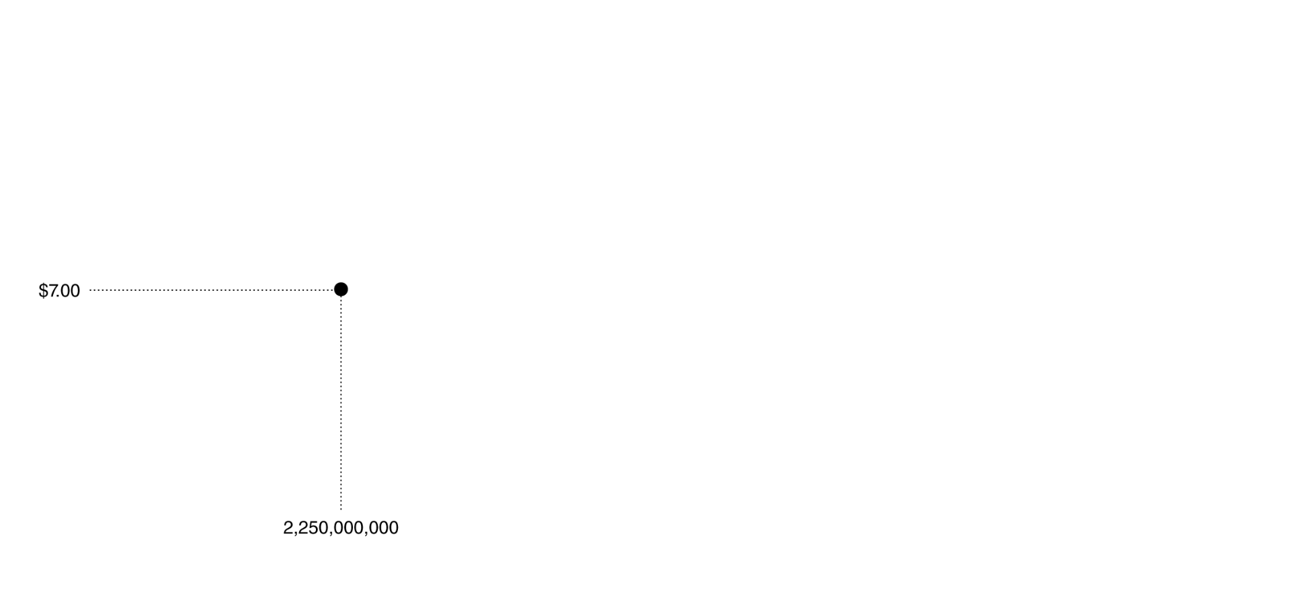
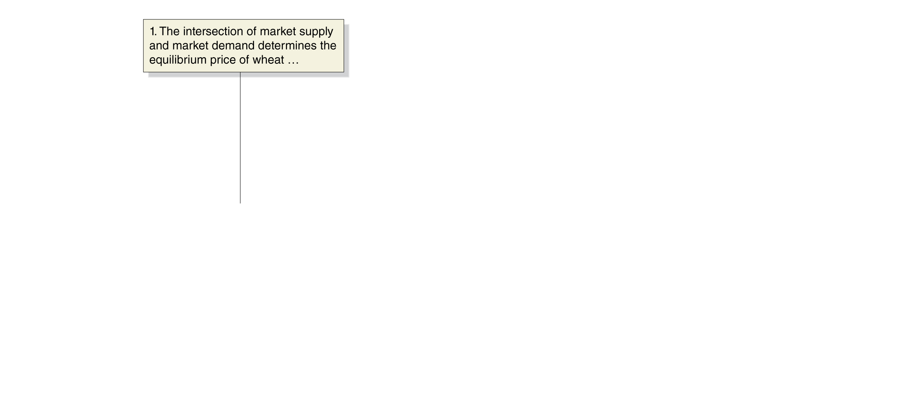

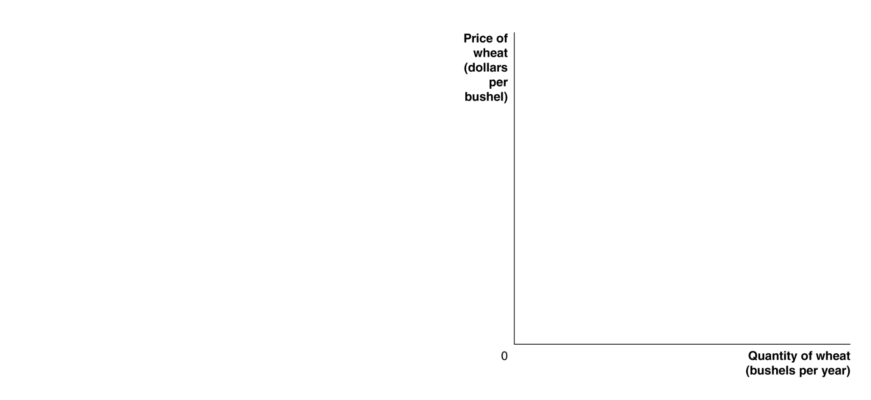
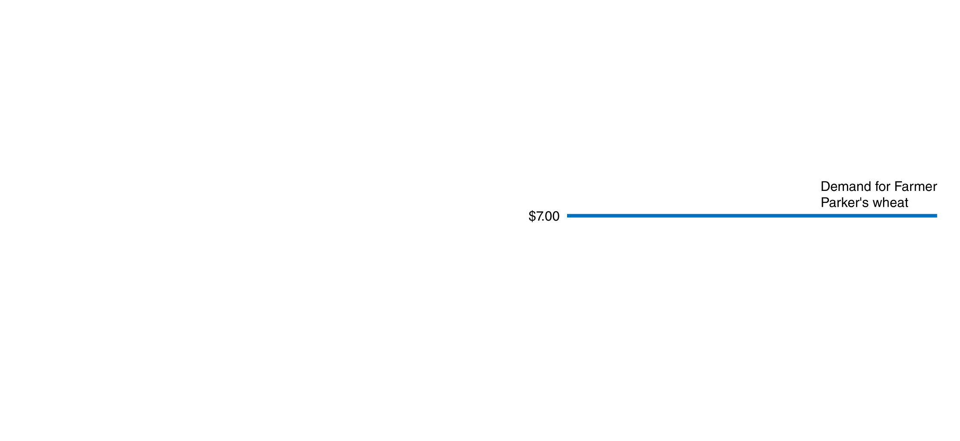
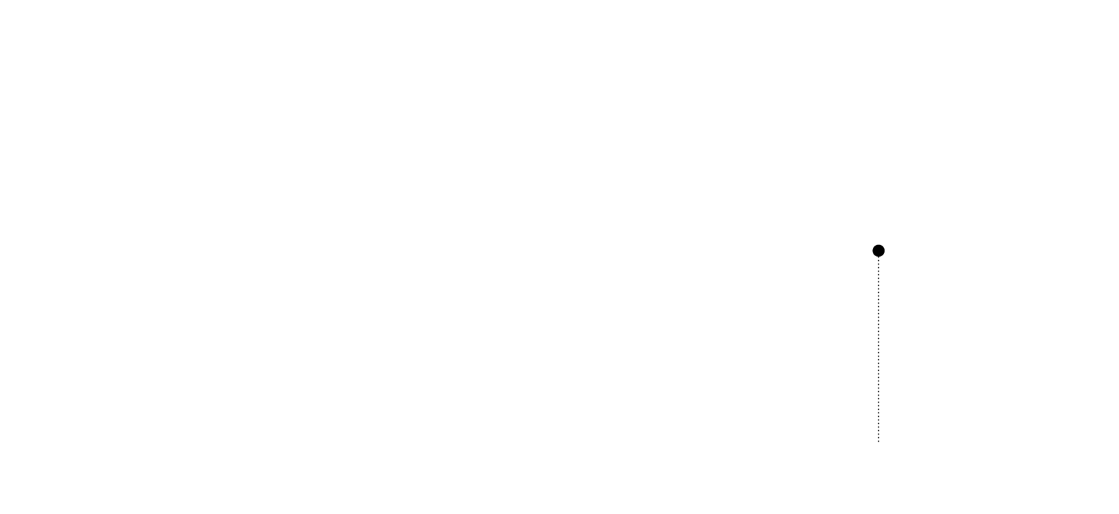
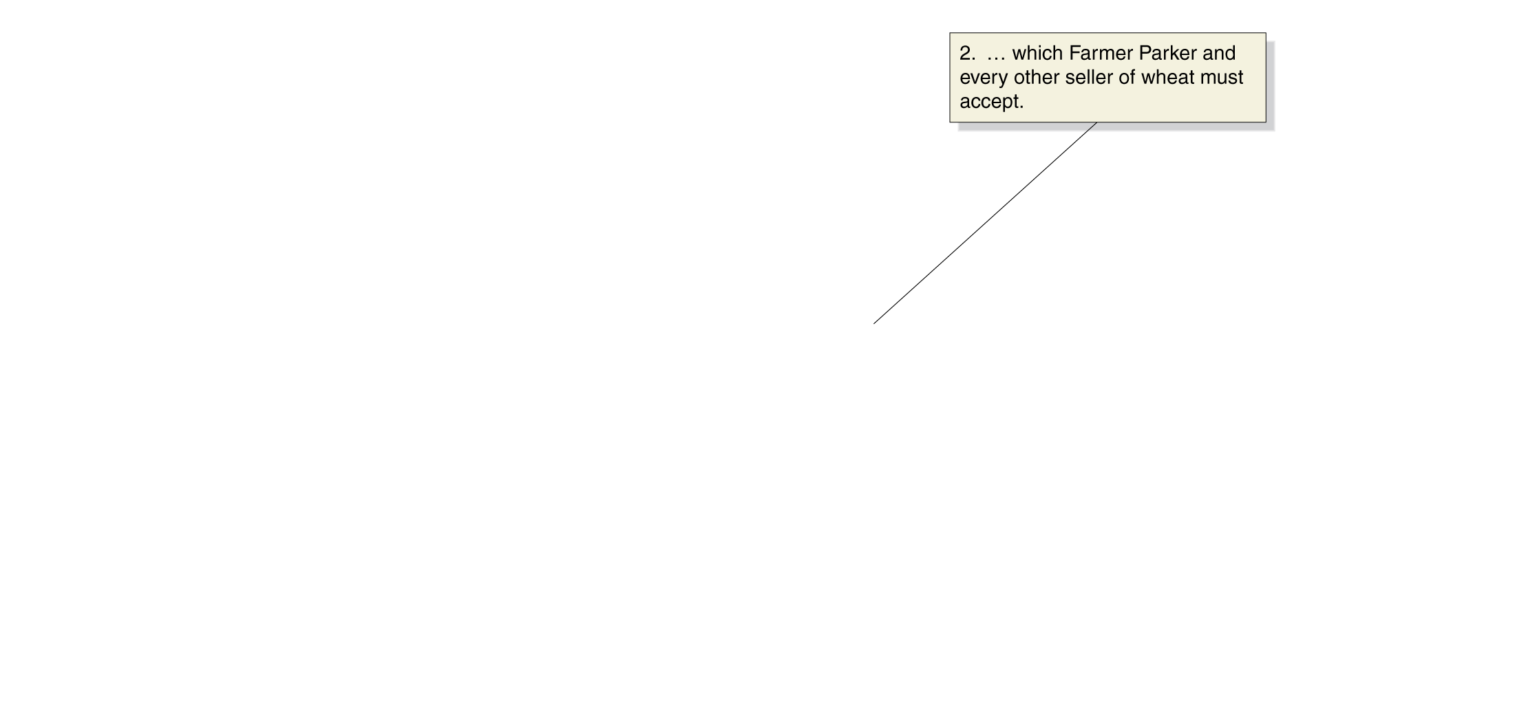
How Is the Firm’s Demand Curve Determined?
There are thousands of individual wheat farmers.
Their collective supply, combined with market demand for wheat, determines the market price.
The individual farmer takes this market price as his or her demand curve.
Notes:
In a perfectly competitive market, price is determined by the intersection of market
demand and market supply. In panel (a), the demand and supply curves for wheat
intersect at a price of $7 per bushel. An individual wheat farmer like Farmer Parker
cannot affect the market price for wheat. Therefore, as panel (b) shows, the demand
curve for Farmer Parker’s wheat is a horizontal line. To understand this figure, it is
important to notice that the scales on the horizontal axes in the two panels are very
different. In panel (a), the equilibrium quantity of wheat is 2.25 billion bushels, and
in panel (b), Farmer Parker is producing only 15,000 bushels of wheat.

Slide 7
Firm Revenue in PC Markets
For Perfectly competitive firms:
Price = Average Revenue = Marginal Revenue
Average revenue: Total revenue divided by the quantity of the product sold.
Marginal revenue: the change in total revenue from selling one more unit of a product.
→ Total Revenue = Price X Quantity

Slide 8
Revenue for a Perfectly Competitive Firm
Number of Bushels (Q) | Market Price (per bushel) (P) | Total Revenue (TR) | Average Revenue (AR) | Marginal Revenue (MR)
0 | $7 | $0 | - | -
1 | 7 | 7 | $7 | $7
2 | 7 | 14 | 7 | 7
3 | 7 | 21 | 7 | 7
4 | 7 | 28 | 7 | 7
5 | 7 | 35 | 7 | 7
6 | 7 | 42 | 7 | 7
7 | 7 | 49 | 7 | 7
8 | 7 | 56 | 7 | 7
9 | 7 | 63 | 7 | 7
10 | 7 | 70 | 7 | 7
For a firm in a perfectly competitive market, price is equal to both average revenue and marginal revenue.

Slide 9
Profit Maximization: the Goal of the Firm
We assume that decisions made by the firm are made solely to maximize firm profit.
For all firms:
Profit = Total Revenue – Total Cost
Firms choose output Q that maximizes this quantity.

Slide 10
Profit Maximization for Farmer Parker
Quantity (bushels) (Q) | Total Revenue (TR) | Total Cost (TC)
0 | $0.00 | $10.00
1 | 7.00 | 14.00
2 | 14.00 | 16.50
3 | 21.00 | 18.50
4 | 28.00 | 21.00
5 | 35.00 | 24.50
6 | 42.00 | 29.00
7 | 49.00 | 35.50
8 | 56.00 | 44.50
9 | 63.00 | 56.50
10 | 70.00 | 72.00
Profit (TR – TC)
-$10.00
-7.00
-2.50
2.50
7.00
10.50
13.00
13.50
11.50
6.50
-2.00
Suppose costs are as in the table.
We can calculate profit; profit is maximized at a quantity of 7 bushels. This is the profit-maximizing level of output.

Slide 11

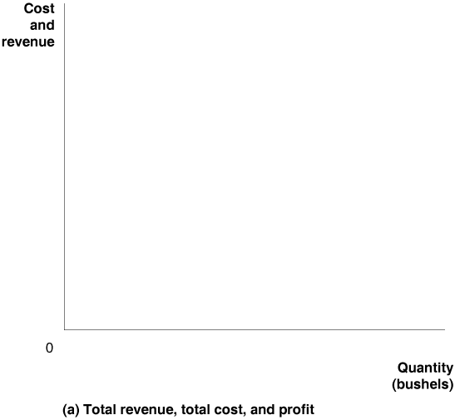

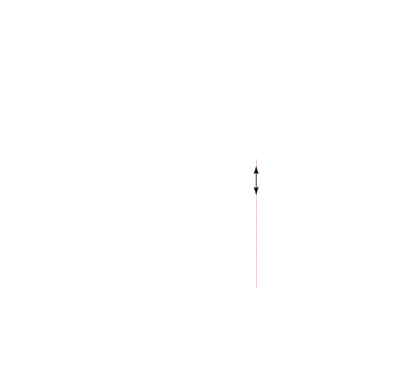
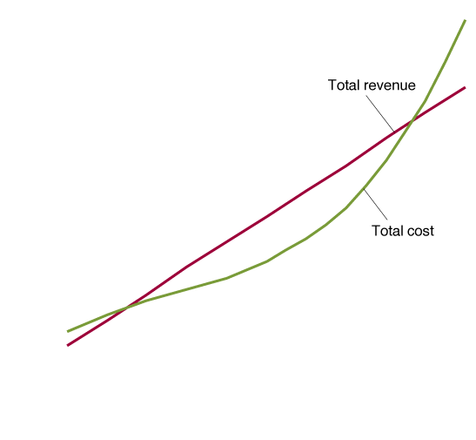
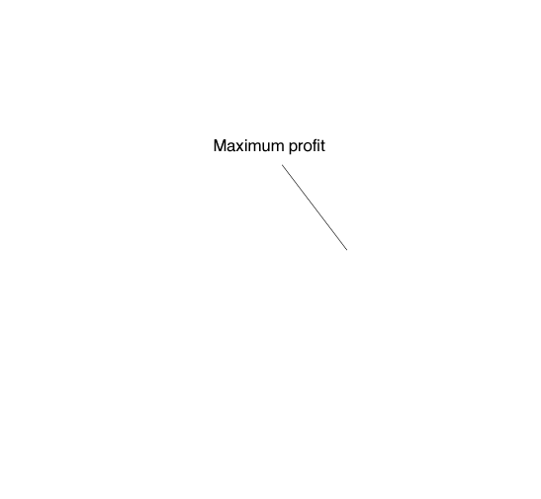
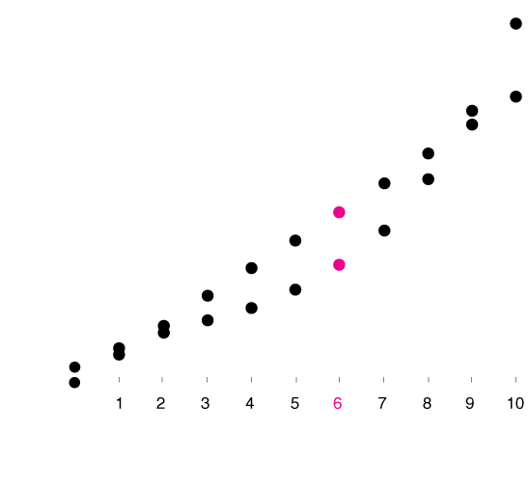
Showing Revenue, Cost, and Profit
Profit = TR – TC
At the profit-maximizing level of output, the vertical distance between TR and TC is maximized.
$49
$35.50
7
Notes:
In panel (a), Farmer Parker maximizes his profit where the vertical distance
between total revenue and total cost is the largest, which occurs at an output
of 7 bushels. Panel (b) shows that Farmer Parker’s marginal revenue (MR) is
equal to a constant $7 per bushel. Farmer Parker maximizes profit by producing
wheat up to the point where the marginal revenue of the last bushel produced
is equal to its marginal cost, or MR = MC. In this case, at no level of output
does marginal revenue exactly equal marginal cost. The closest Farmer Parker
can come is to produce 7 bushels of wheat. He will not want to continue to produce
once marginal cost is greater than marginal revenue because that would
reduce his profits. Panels (a) and (b) show alternative ways of thinking about
how Farmer Parker can determine the profit-maximizing quantity of wheat to
produce.

Slide 12
Finding Maximum Profit
Total Profit
Profit unchanging
$13.50
Profit decreasing
Profit increasing
7
Output, Q

Slide 13

Profit Maximization: the Goal of the Firm
For all firms, choose Q such that:
$$\frac{Δprofit}{ΔQ}=\frac{Δtotal revenue}{ΔQ}−\frac{Δtotal cost}{ΔQ}=0$$
Then,
$$\frac{Δtotal revenue}{ΔQ}=\frac{Δtotal cost}{ΔQ}$$
Or…
MR = MC

Slide 14
Profit Maximization for Farmer Parker: MR=MC
Quantity (bushels) (Q) | Total Revenue (TR) | Total Cost (TC) | Profit (TR – TC) | Marginal Revenue (MR) | Marginal Cost (MC)
0 | $0.00 | $10.00 | -$10.00 | - | -
1 | 7.00 | 14.00 | -7.00 | $7.00 | $4.00
2 | 14.00 | 16.50 | -2.50 | 7.00 | 2.50
3 | 21.00 | 18.50 | 2.50 | 7.00 | 2.00
4 | 28.00 | 21.00 | 7.00 | 7.00 | 2.50
5 | 35.00 | 24.50 | 10.50 | 7.00 | 3.50
6 | 42.00 | 29.00 | 13.00 | 7.00 | 4.50
7 | 49.00 | 35.50 | 13.50 | 7.00 | 6.50
8 | 56.00 | 44.50 | 11.50 | 7.00 | 9.00
9 | 63.00 | 56.50 | 6.50 | 7.00 | 12.00
10 | 70.00 | 72.00 | -2.00 | 7.00 | 15.50
Profit is maximized by producing as long as MR>MC; or until MR=MC, if that is possible.

Slide 15

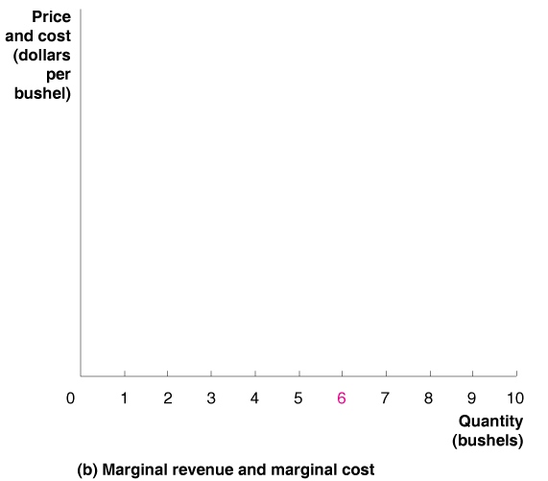
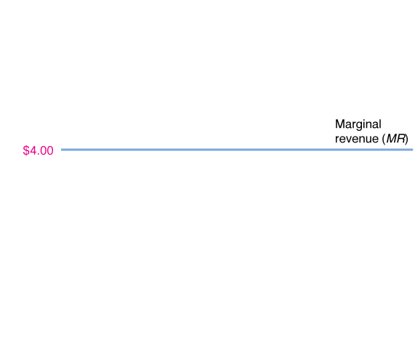
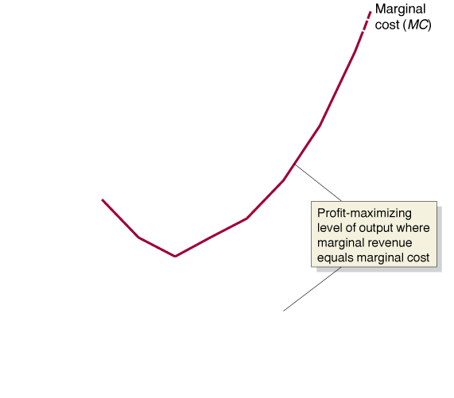
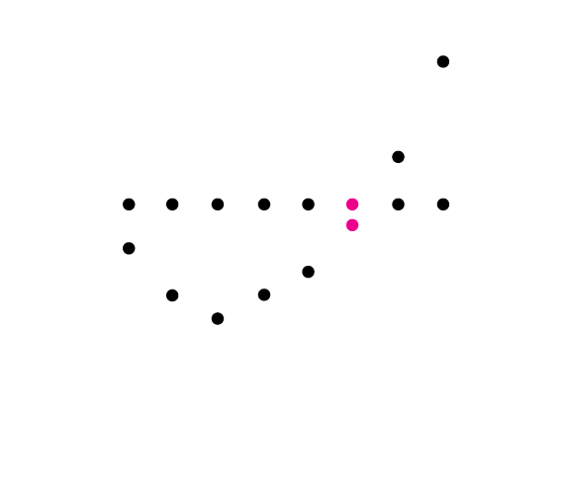
Showing Marginal Revenue and Marginal Cost
$/unit
The firm maximizes profit by choosing the level of output where MR is equal to MC
(or just less, if equal is not possible).
$7
7
Q

Slide 16
Rules for Profit Maximization
The rules we have just developed are:
The profit-maximizing level of output is where the difference between total revenue and total cost is greatest.
The profit-maximizing level of output is also where MR = MC.
However neither of these rules require the assumption of perfect competition; they are true for every firm!
For PC firms, P = MR; this implies:
The profit-maximizing level of output is also where P = MC.

Slide 17
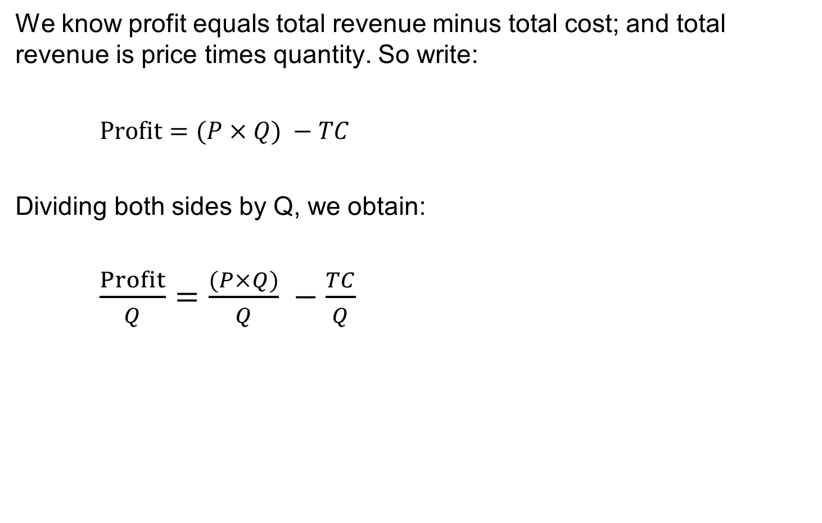
A Useful Formula for Profit
We know profit equals total revenue minus total cost; and total revenue is price times quantity. So write:
$Profit=(P×Q) −TC$
Dividing both sides by Q, we obtain:
$\frac{Profit}{Q}=\frac{(P×Q)}{Q} −\frac{TC}{Q}$

Slide 18
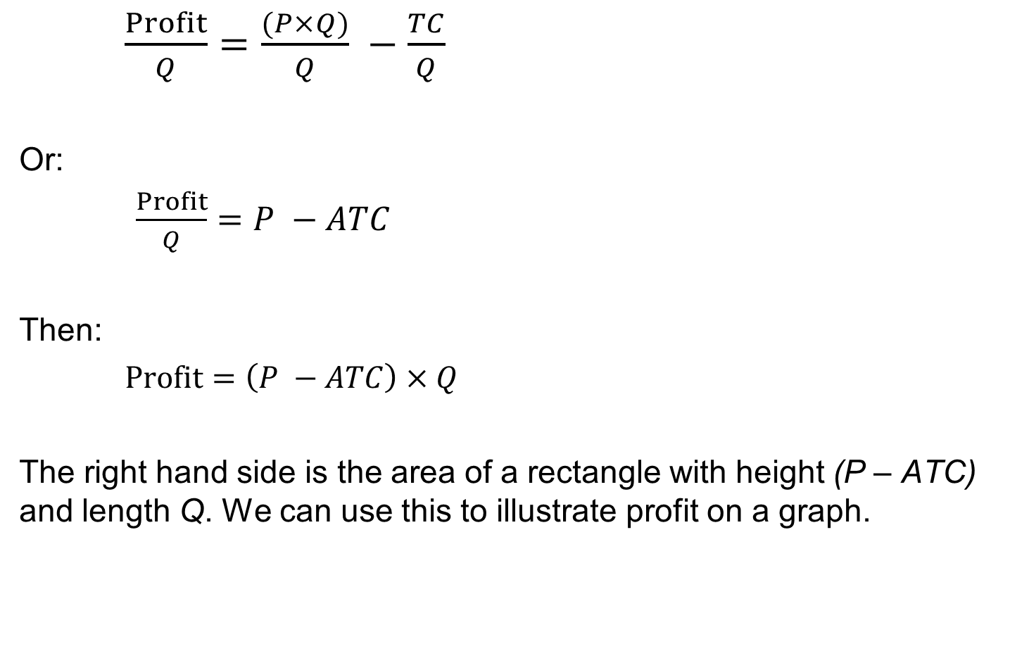
A Useful Formula for Profit
$\frac{Profit}{Q}=\frac{(P×Q)}{Q} −\frac{TC}{Q}$
Or:
$\frac{Profit}{Q}=P −ATC$
Then:
$Profit=\left(P −ATC\right)×Q$
The right hand side is the area of a rectangle with height (P – ATC) and length Q. We can use this to illustrate profit on a graph.

Slide 19

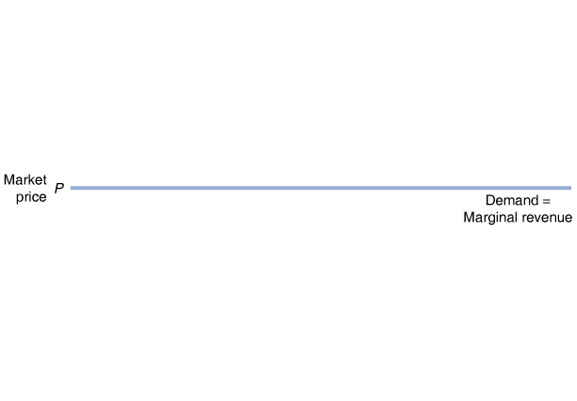
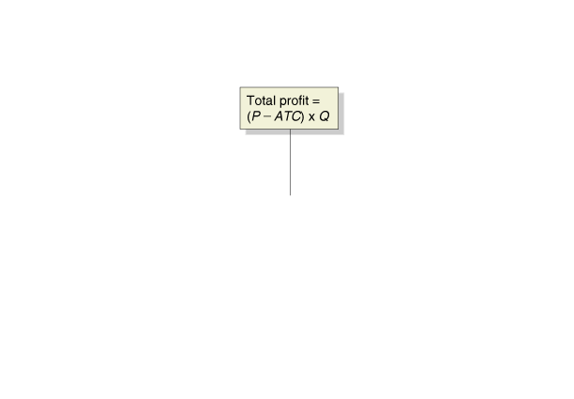
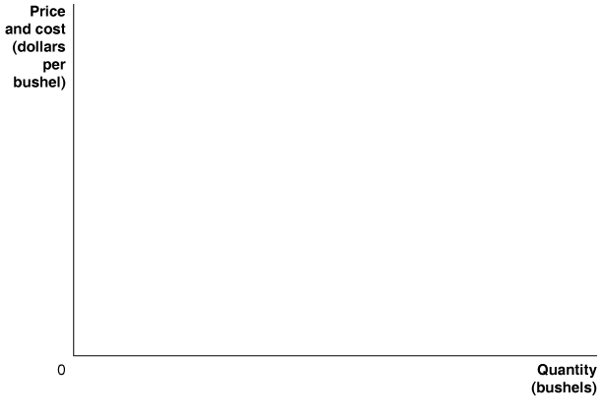
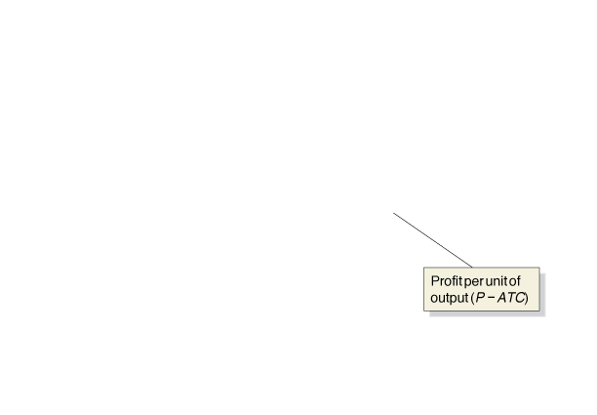
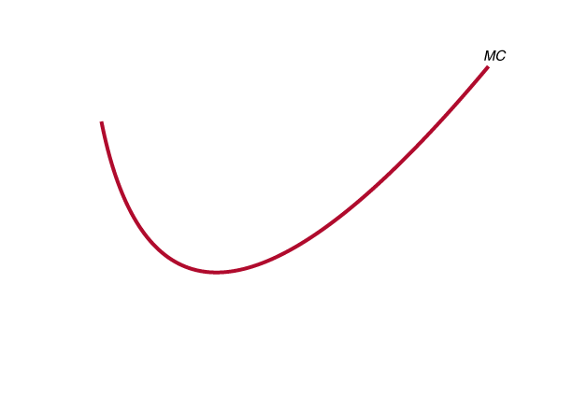
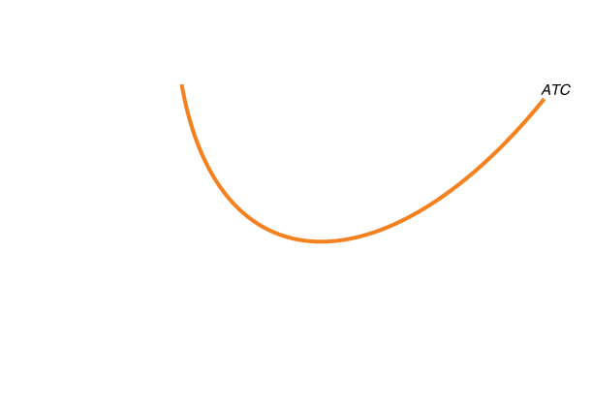
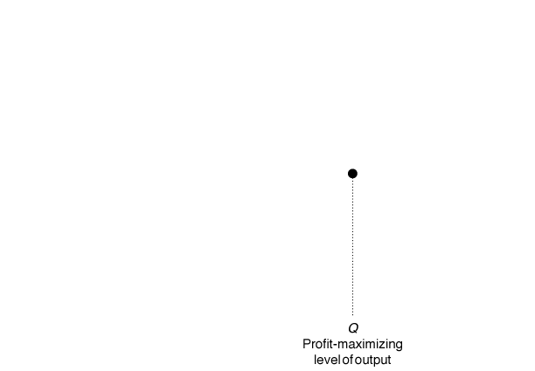
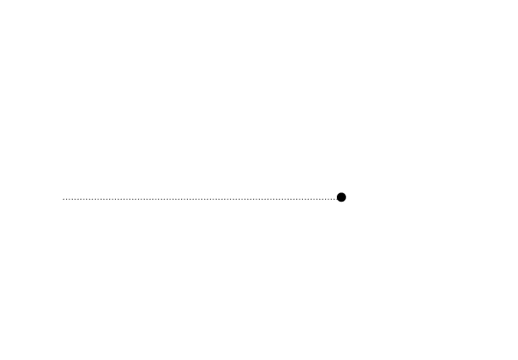
Showing the Maximum Profit on a Graph
Firm chooses Q where MR=MC
P-ATC = Profit/unit of output
Profit =Profit/unit of output X the amount of output
Notes:
A firm maximizes profit at the level of output
at which marginal revenue equals marginal
cost. The difference between price and
average total cost equals profit per unit of
output. Total profit equals profit per unit
multiplied by the number of units produced.
Total profit is represented by the area of the
green-shaded rectangle, which has a height
equal to (P - ATC) and a width equal to Q.

Slide 20
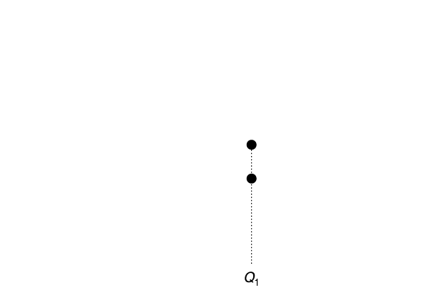
Incorrect Level of Output
Why not produce Q₁, where profit per unit is maximized?
MR>MC at Q₁; you could still get additional profit for producing above Q₁.

Slide 21
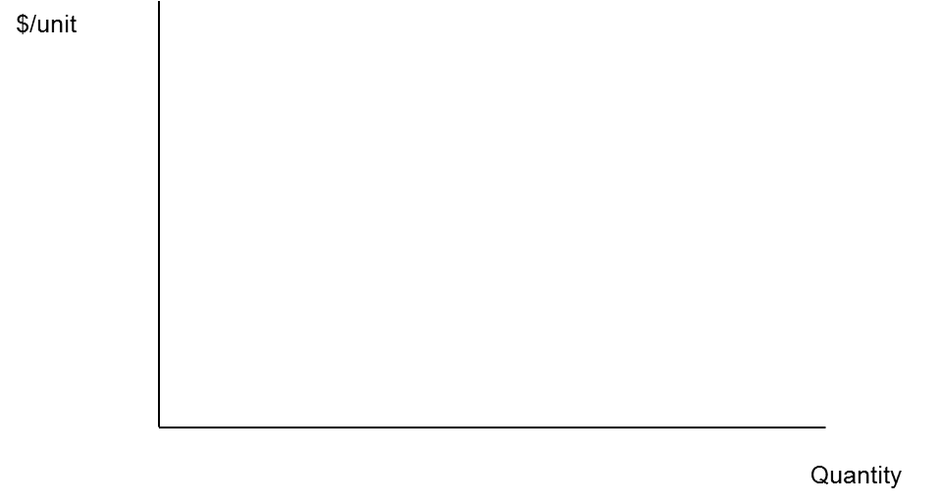
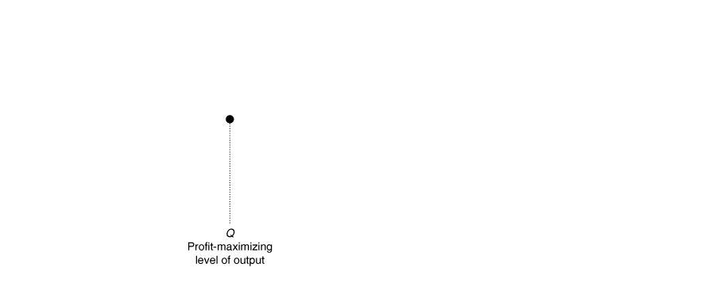
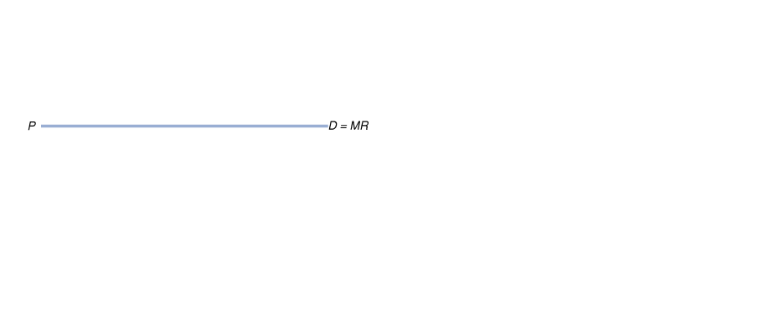

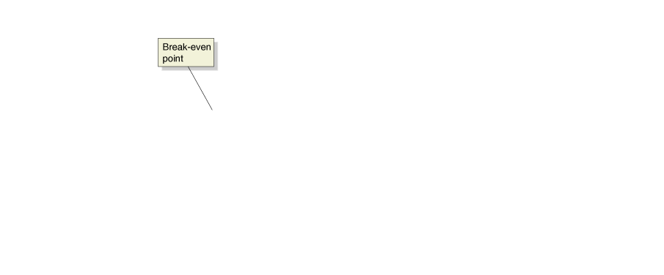
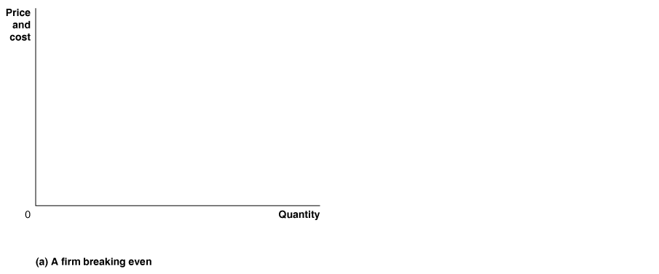
A Firm Breaking Even – When Maximum Profit is No Profit
Here, the best this firm can do is to break even, obtaining no profit but incurring no loss.
The MC=MR rule still leads us to this optimal level of production.
Notes:
In panel (a), price equals average total cost, and the firm breaks even because its
total revenue will be equal to its total cost. In this situation, the firm makes zero
economic profit.
In panel (b), price is below average total cost, and the firm experiences a loss. The
loss is represented by the area of the red-shaded rectangle, which has a height
equal to (ATC – P) and a width equal to Q.

Slide 22
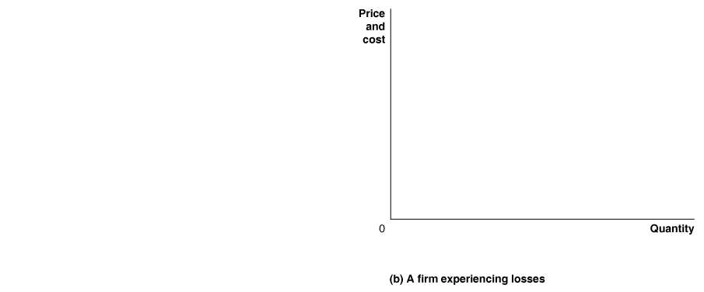
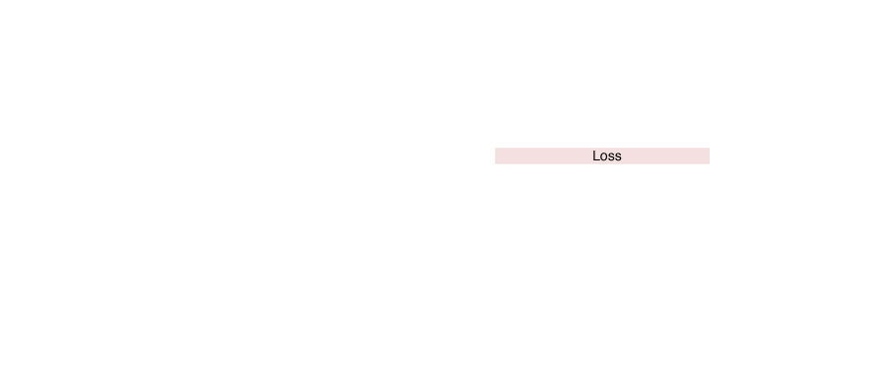
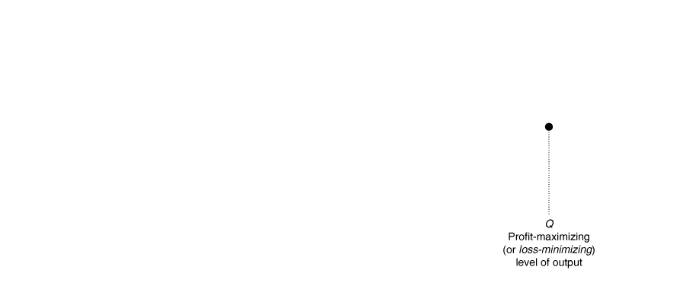
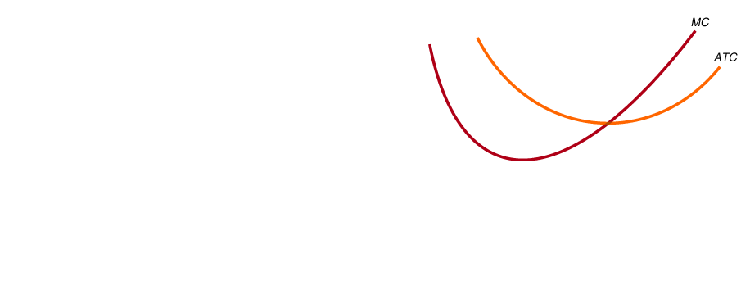
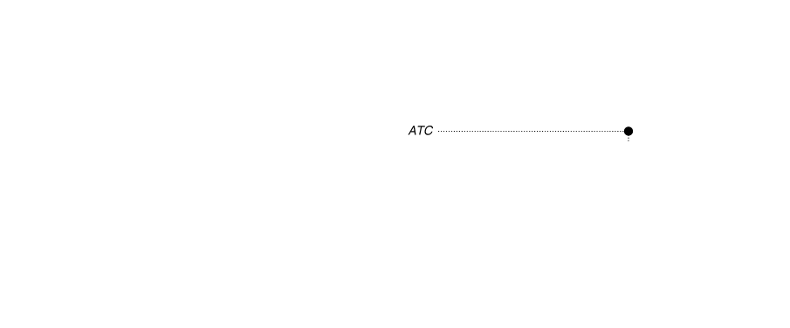
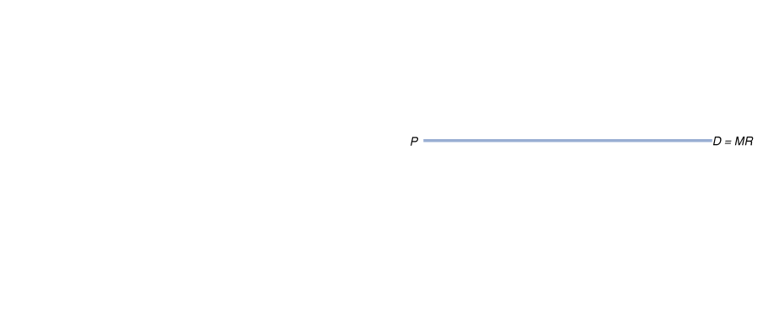
A Firm Experiencing a Loss
Not only can this firm not make a profit, price is always lower than average total cost, so it must make a loss.
The firm is still profit maximizing at MC=MR!
$/unit
Quantity

Slide 23
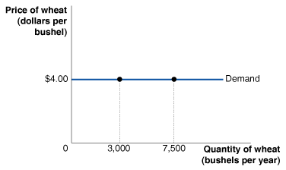
Refer to the figure below. What is this graph trying to explain?
The decision of a producer to charge $4.00 for 3,000 bushels or for 7,500 bushels.
Uncertainty about producing 3,000 or 7,500 bushels given the market price of $4.00.
How market demand and the firm’s demand curve are one and the same in a perfectly competitive market.
The ability of the perfectly competitive firm to sell any amount of output as long as it accepts the market price of $4.00.

Slide 24
Refer to the figure below. What is this graph trying to explain?
d. The ability of the perfectly competitive firm to sell any amount of output as long as it accepts the market price of $4.00.

Slide 25
Fill in the table for a price taking firm in a competitive market. How does the marginal revenue of the 5th good sold compare to the price?
Quantity
Price
($)
Total revenue
($)
Average revenue
($)
Marginal revenue
($)
1
95
2
3
4
5
Notes:
The price received per bunch remains constant, because the firm is a price taker in a competitive market.

Slide 26
Fill in the table for a price taking firm in a competitive market. How does the marginal revenue of the 5th good sold compare to the price?
Quantity
Price
($)
Total revenue
($)
Average revenue
($)
Marginal revenue
($)
1
95
95
95
95
2
95
190
95
95
3
95
285
95
95
4
95
380
95
95
5
95
475
95
95
They are equal at every level of output in a perfectly competitive market.
Notes:
The price received per bunch remains constant, because the firm is a price taker in a competitive market.

Slide 27
Find the profit maximizing quantity below
Quantity
Total revenue
Total cost
Profit
Marginal
Marginal
cost
Marginal
profit
of plantains
revenue
(bunches)
(CFA Francs)
(CFA Francs)
(CFA Francs)
(CFA Francs)
(CFA Francs)
(CFA Francs)
0
0
700
-
-
-
1
800
1,200
80
0
500
2
1,600
1,800
80
0
600
3
2,400
2,600
80
0
800
4
3,200
3,600
80
0
1,000
5
4,000
4,800
-
80
0
1,200
Notes:
When firms find themselves in this situation, they have to decide if this is a short-run phenomena or a long-run trend. Based on this analysis, they will decide whether to shut down or exit the market.

Slide 28
Find the profit maximizing quantity below
Quantity
Total revenue
Total cost
Profit
Marginal
Marginal
cost
Marginal
profit
of plantains
revenue
(bunches)
(CFA Francs)
(CFA Francs)
(CFA Francs)
(CFA Francs)
(CFA Francs)
(CFA Francs)
0
0
700
-700
-
-
-
1
800
1,200
-40
0
80
0
500
300
2
1,600
1,800
-20
0
80
0
600
200
3
2,400
2,600
-200
80
0
800
0
4
3,200
3,600
-40
0
80
0
1,000
-200
5
4,000
4,800
-80
0
80
0
1,200
-400
Even though profit is maximized, it is negative.
(But still better than zero output- why?)
If P < ATC, then profits will be negative.
Why not choose Q=2?
Notes:
When firms find themselves in this situation, they have to decide if this is a short-run phenomena or a long-run trend. Based on this analysis, they will decide whether to shut down or exit the market.

Slide 29
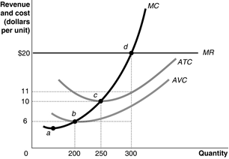
Calculate firm profits when firm costs and marginal revenue are as shown.

Slide 30
Calculate firm profits when firm costs and marginal revenue are as shown.
Profit = (P-ATC)*q = ($20-$11)*300=$2700

